Slide 1

VigilDQ — a guided tour
AI-native data quality with guardrails built into the architecture
A screenshot walkthrough of the real product — read it in ten minutes, no meeting required. Every screen shown is live software, not a mock-up.
Version 0.20.3 · PostgreSQL + Databricks validated live · Built for regulated industries

Slide 2
Executive summary
The idea
• An LLM drafts data-quality rules from a profile of your data.
• Hard structural guardrails vet every proposal — then a human approves.
• Approved rules run as read-only SQL inside your warehouse.
What makes it different
• Guardrails are architecture, not prompt instructions.
• The AI can never approve its own work — the lifecycle forbids it.
• PII is masked before the AI or the browser ever sees a value.
Where it stands
• PostgreSQL and Databricks / Unity Catalog validated live.
• 370+ automated tests; full audit trail; multi-tenant service.
• SQL Server dialect implemented, live validation next.
Who it's for
• Pharma, banking, insurance — teams that must PROVE data quality.
• Data platform owners who want AI speed without AI risk.

Slide 3
The workflow
→
→
→
→
→
Connect
encrypted, read-only
Scan
profile, masked samples
Propose
AI drafts rules
Review
a human approves
Run
scored in-warehouse
Automate
schedules, gates, alerts
Six steps from raw table to governed, continuously-scored dataset — the next ten slides walk through them on the real product.

Slide 4
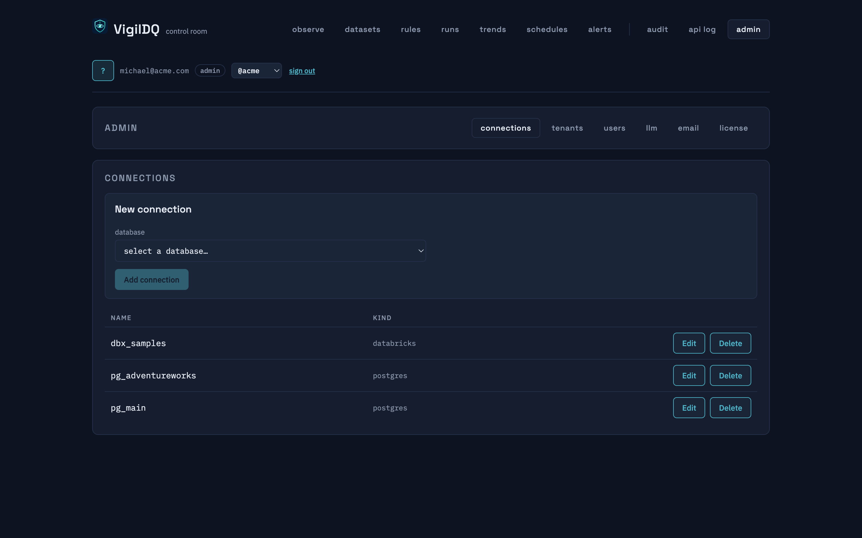
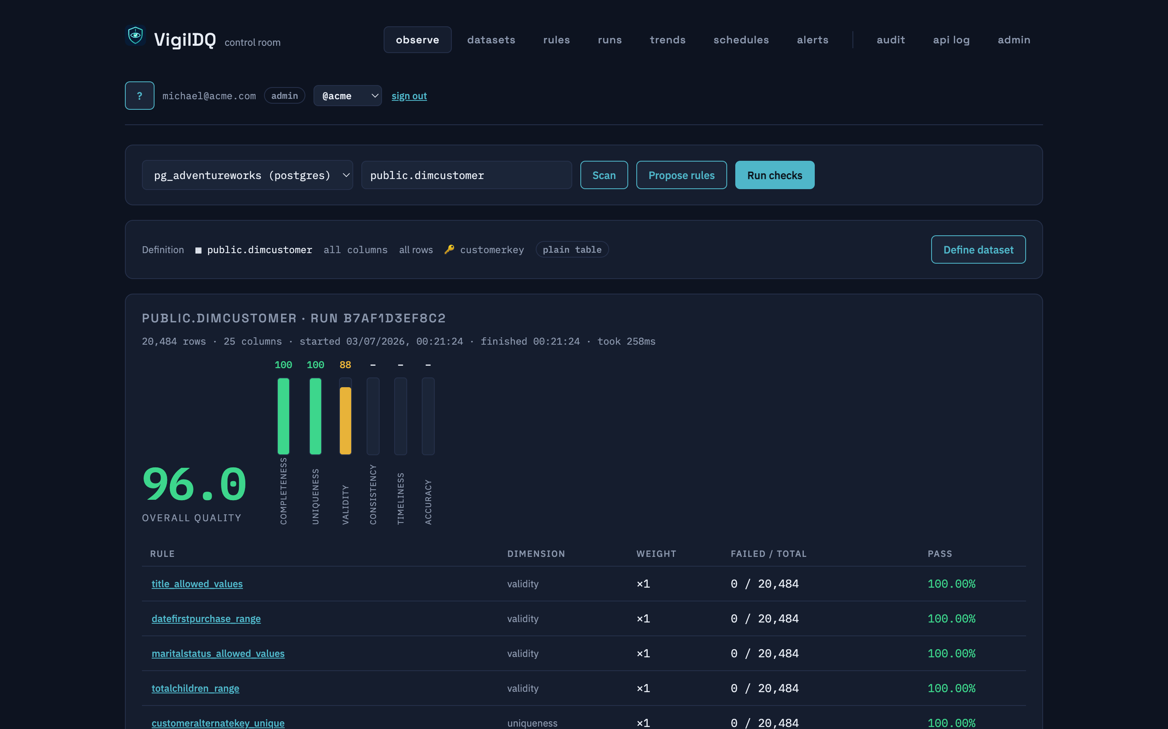
Connect a warehouse, define the dataset
connections — encrypted at rest, read-only credentials
the dataset definition — one click to restrict columns/rows
▸ Secrets are Fernet-encrypted; rule execution needs read-only grants only.
▸ Logical datasets: restrict columns and rows (e.g. SCD2 current rows) — rules, profiling and drift all respect the restriction.
WHY IT MATTERS
Your raw data never leaves the warehouse — VigilDQ pushes queries down and stores results, not rows.

Slide 5
Score the dataset
▸ One 0–100 quality score, decomposed into six dimensions: completeness, uniqueness, validity, consistency, timeliness, accuracy.
▸ Every rule shows failed/total and its pass ratio — the score is explainable all the way down.
▸ An erroring rule scores zero and is surfaced — never silently skipped.
WHY IT MATTERS
A number a steering committee can track, with the drill-down an auditor can defend.

Slide 6
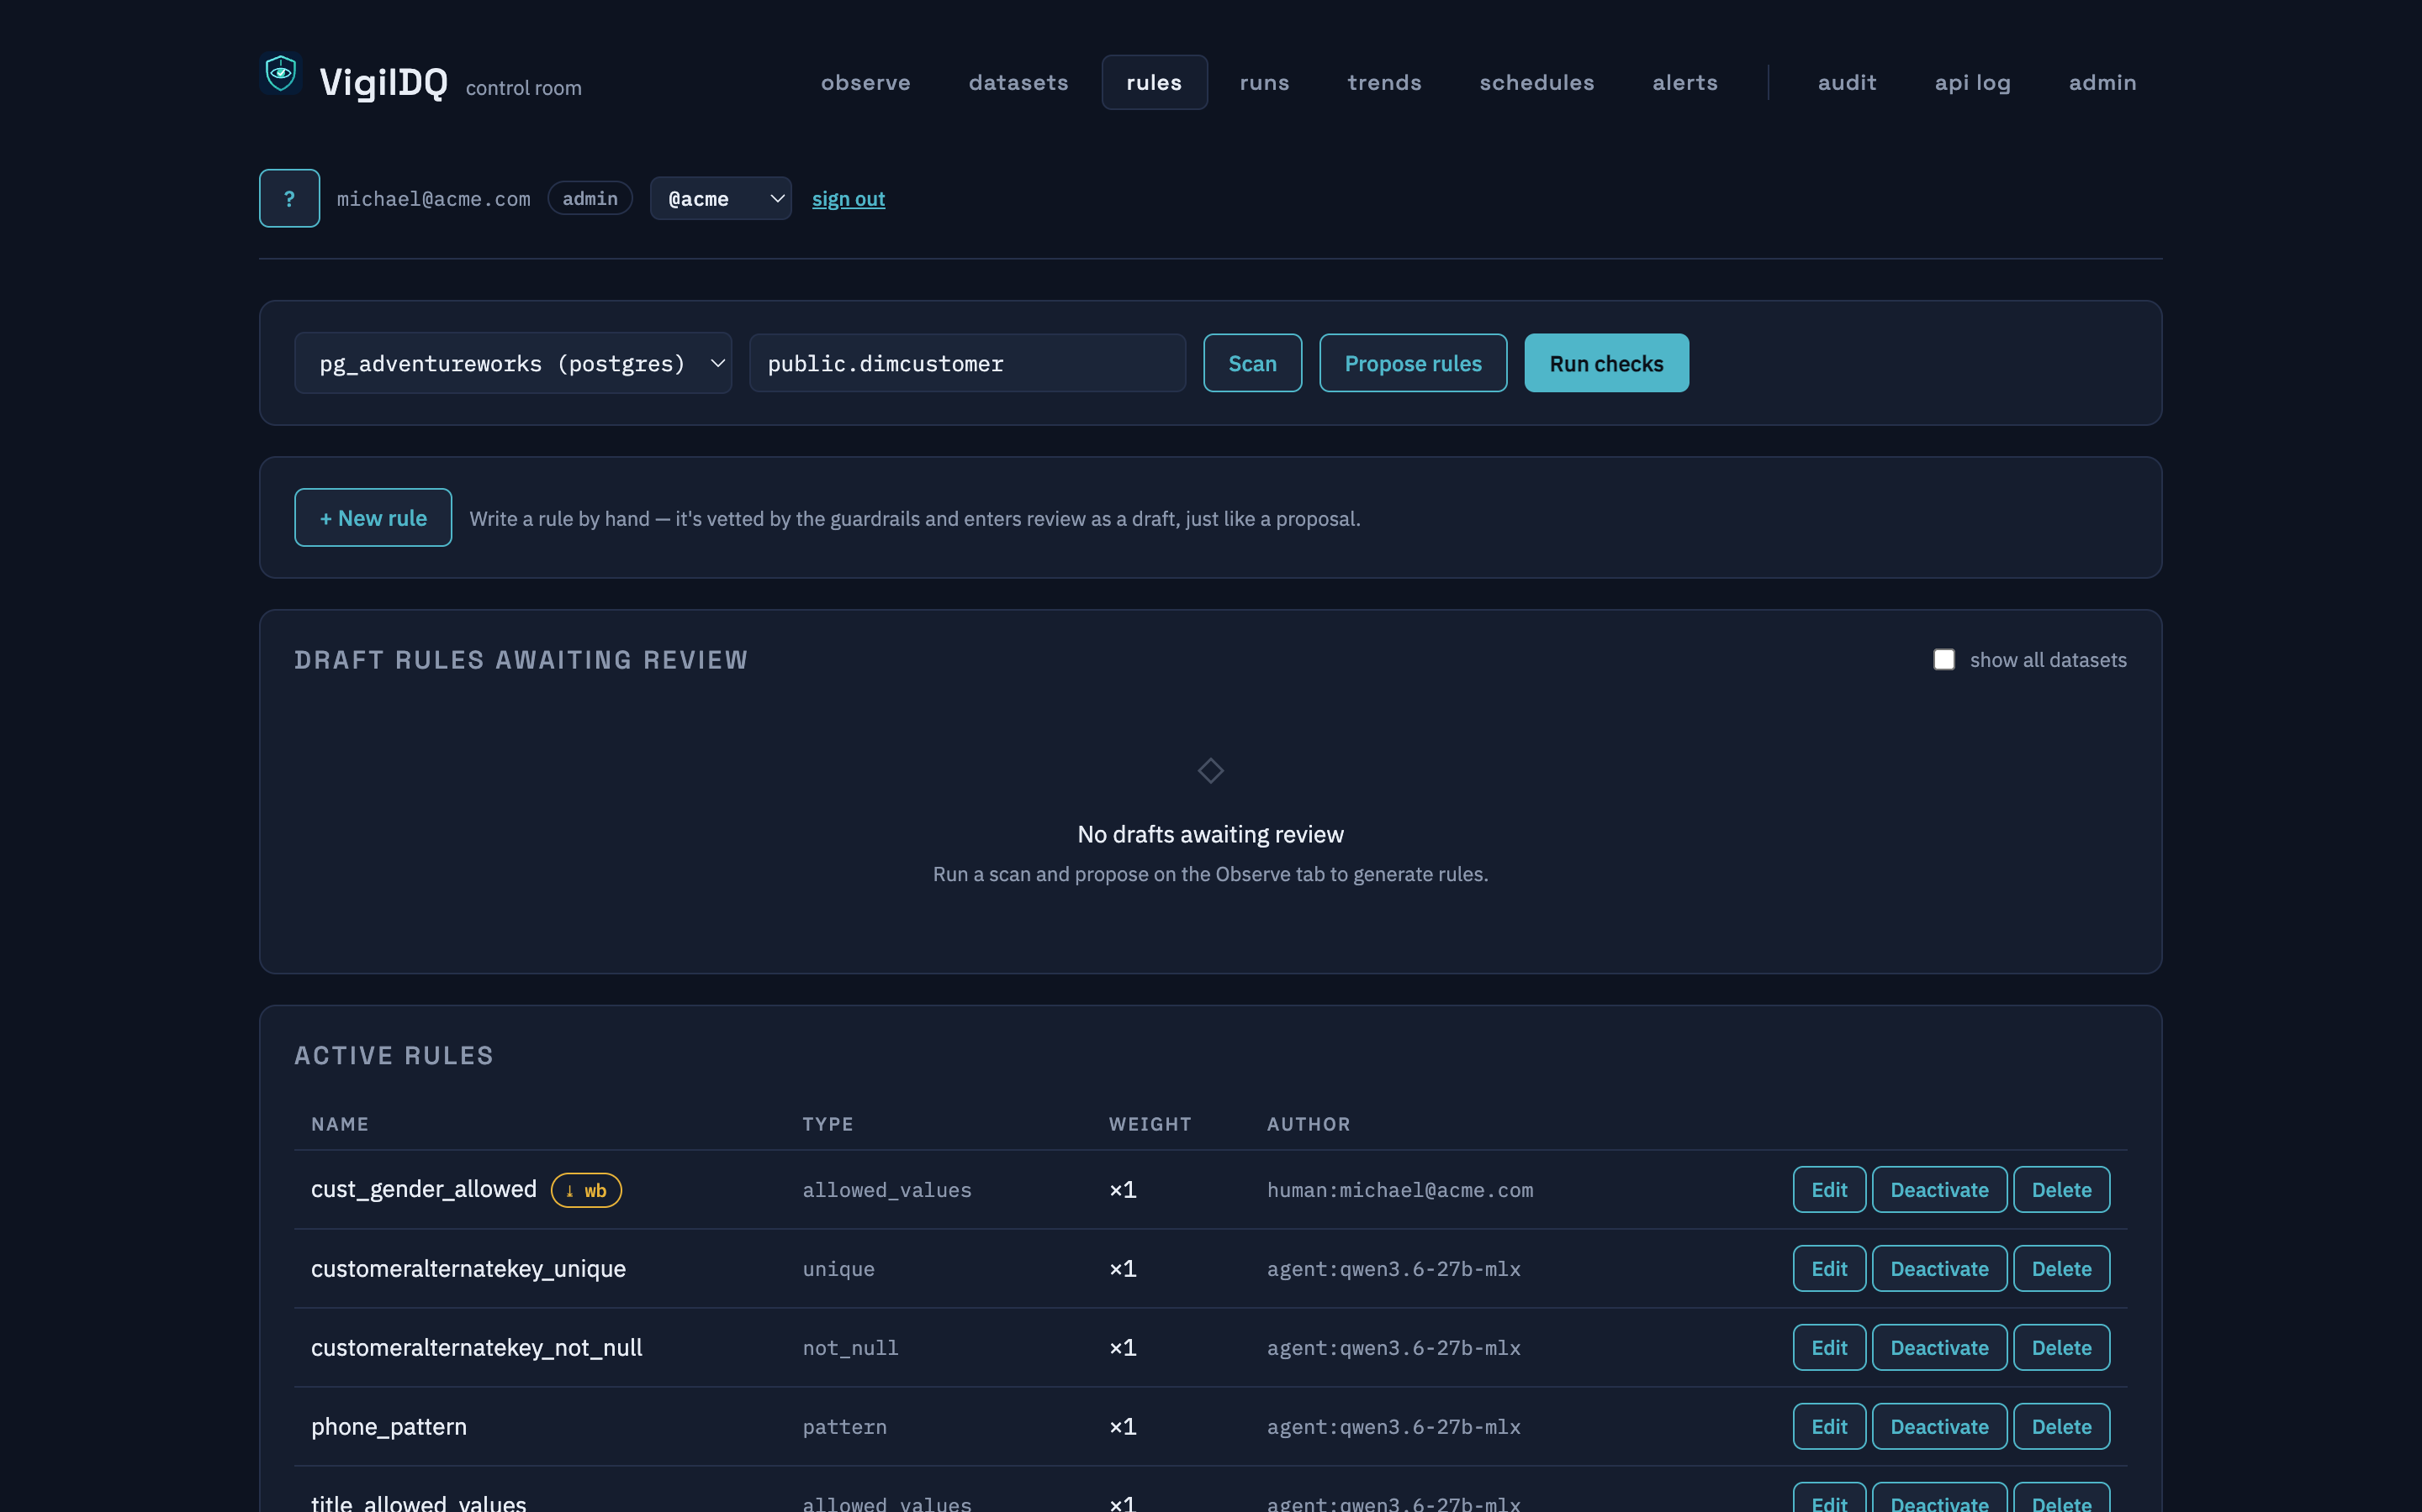
Review before anything runs
▸ AI proposals land as drafts with a rationale grounded in the profile.
▸ Approve, reject, edit or delete — the agent cannot activate anything.
▸ The approving human is recorded on every rule (human:<email>).
▸ Hand-written rules go through exactly the same gates.
WHY IT MATTERS
Change control is built in: no AI-authored check ever runs without a reviewer credential approving it — the agent can never approve its own work.

Slide 7
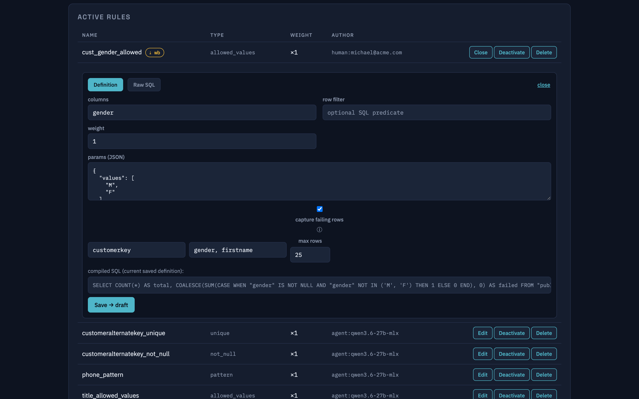
Every rule is inspectable SQL
▸ View the compiled SQL for any rule, per engine dialect.
▸ Edit the definition — or override with raw SQL for edge cases.
▸ Any logic change is re-vetted by the guardrails and reset to draft for re-approval.
WHY IT MATTERS
No black boxes: your DBAs can read every control, and edits can't bypass review.

Slide 8
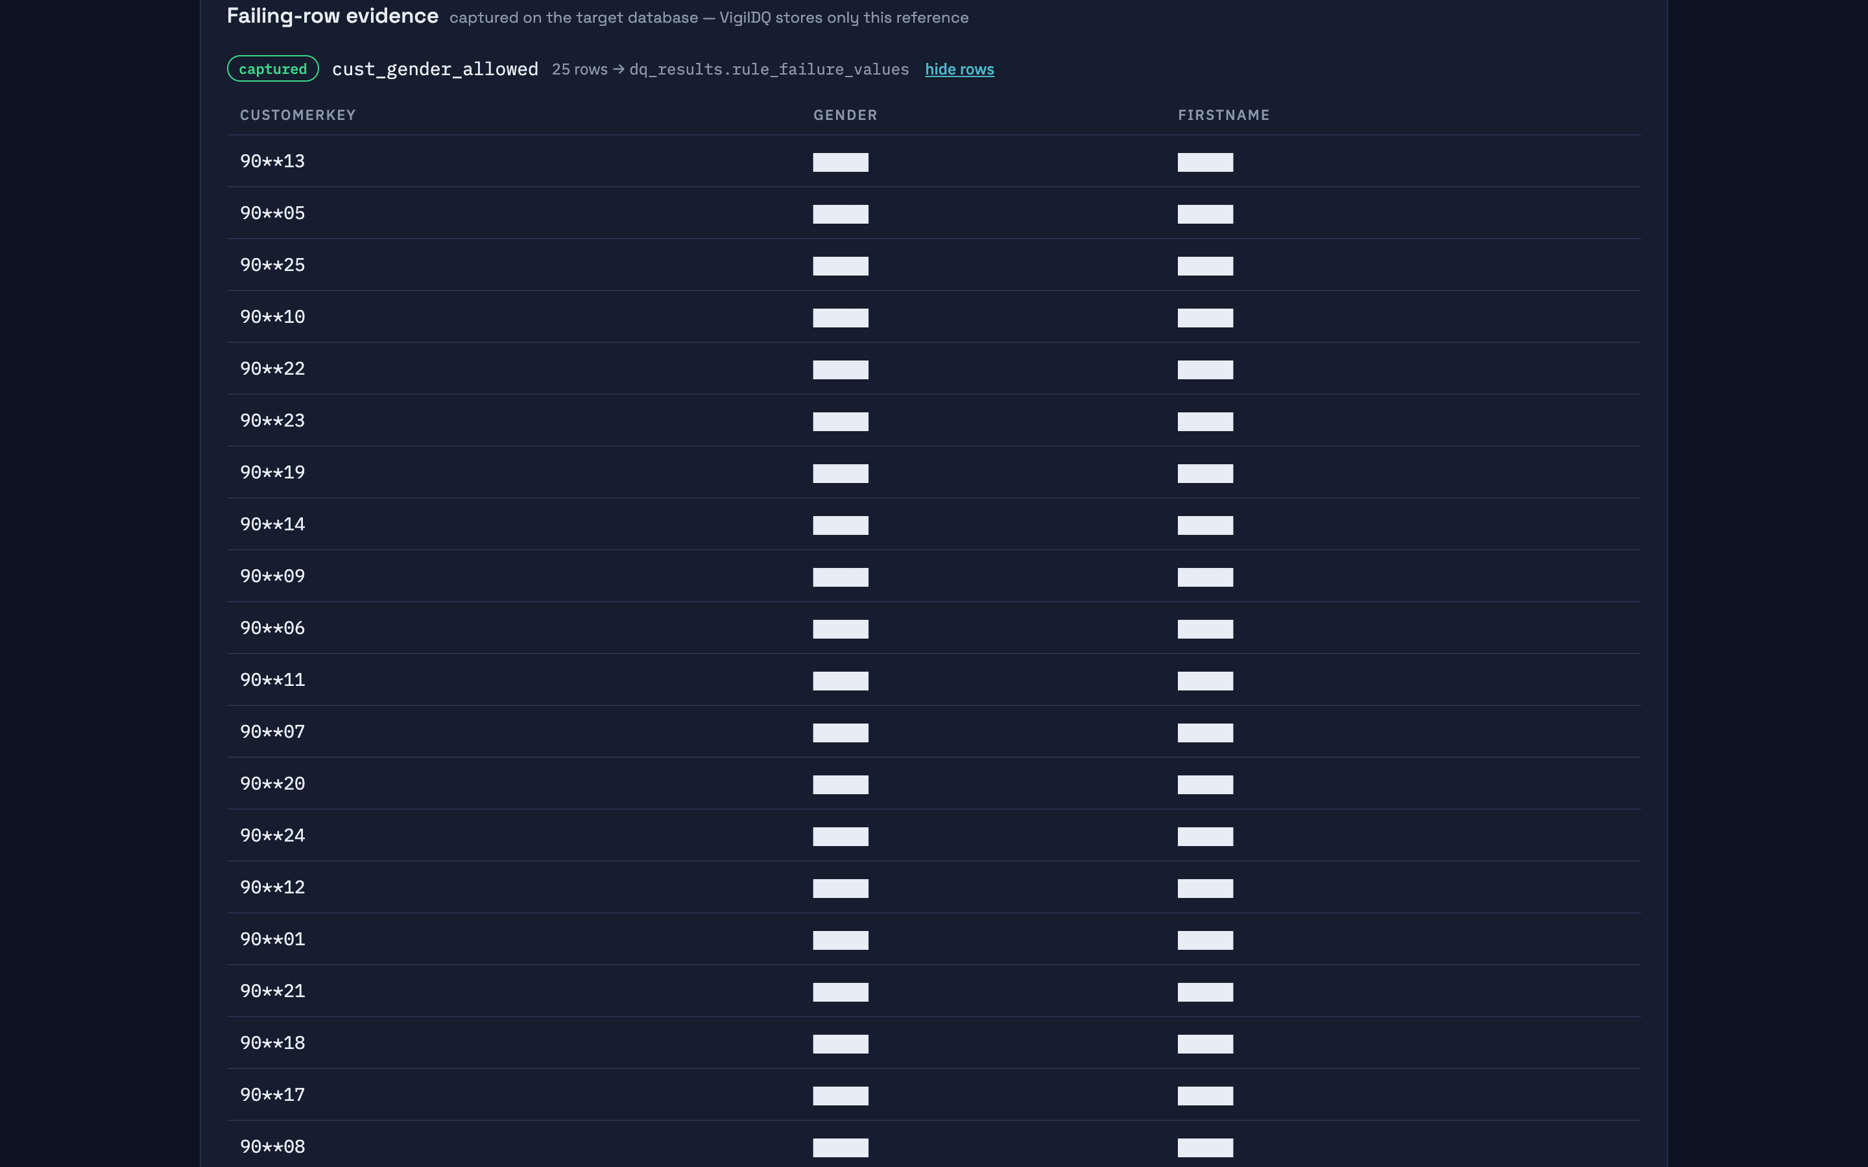
Evidence stays in YOUR database
▸ Failing rows are captured into a DQ schema on the target warehouse — keys plus the offending values.
▸ Capped, fail-soft, and written by a separate writer grant scoped to that schema only.
▸ The drill-down masks PII at the boundary (names show as initials).
WHY IT MATTERS
When an auditor asks "show me the failing rows", the answer lives in your own database — not in a vendor's cloud.

Slide 9
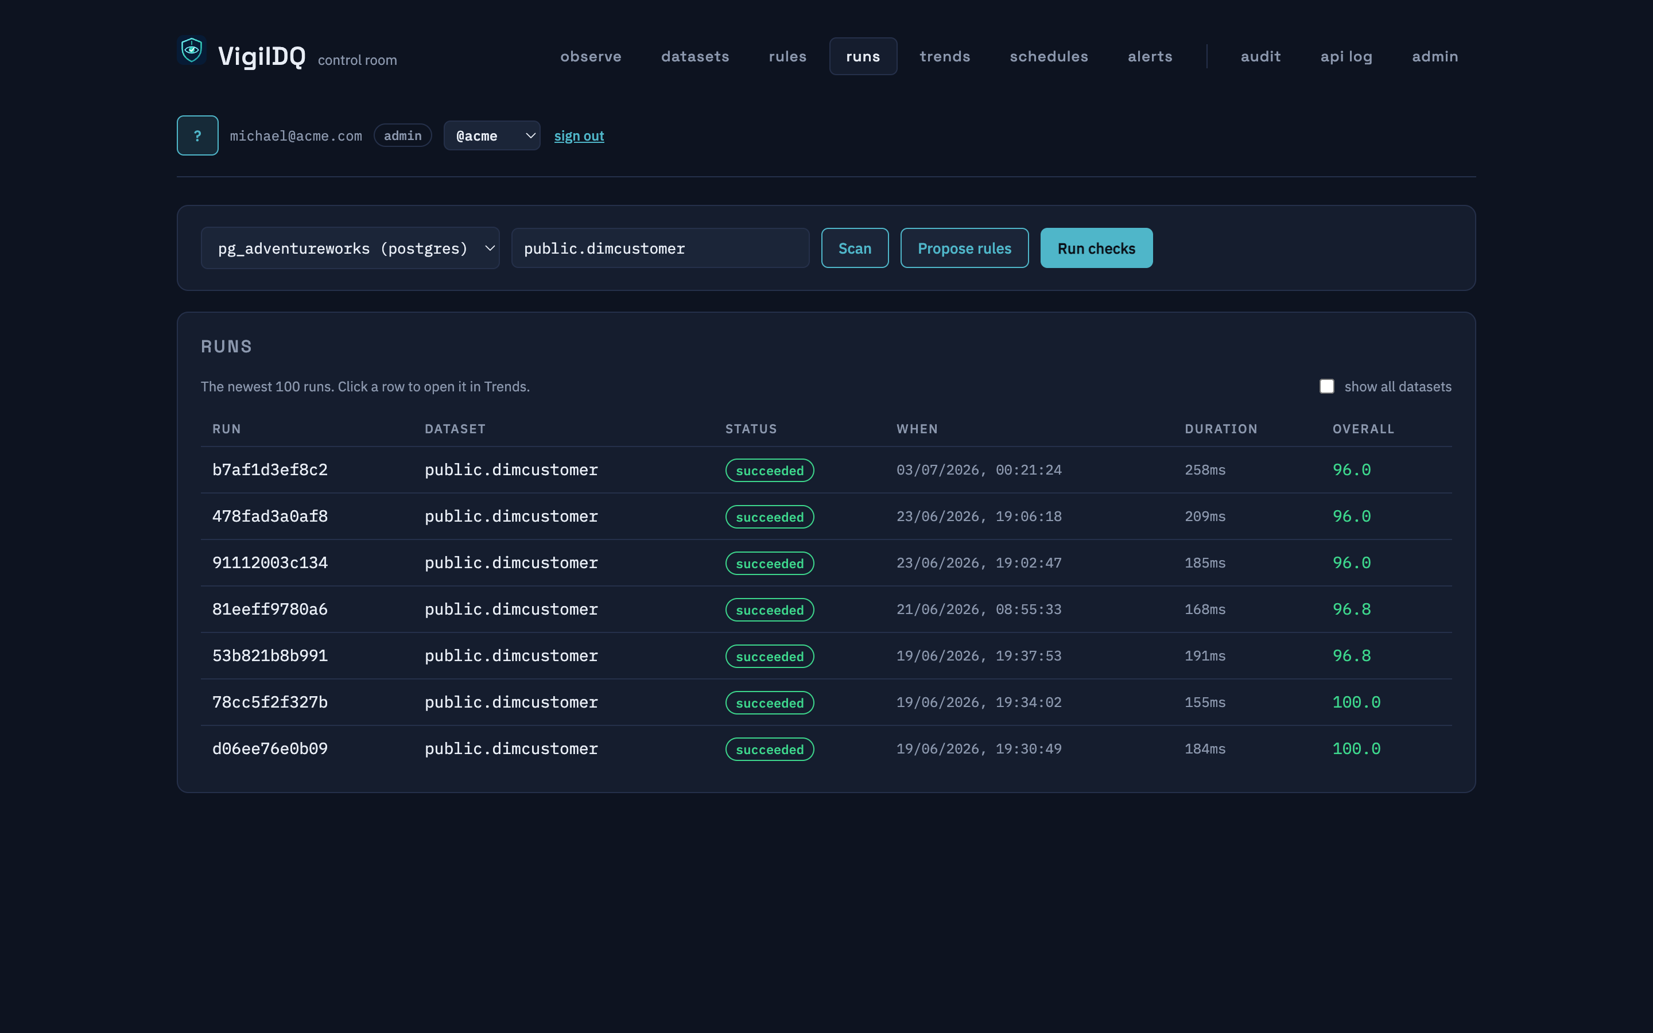
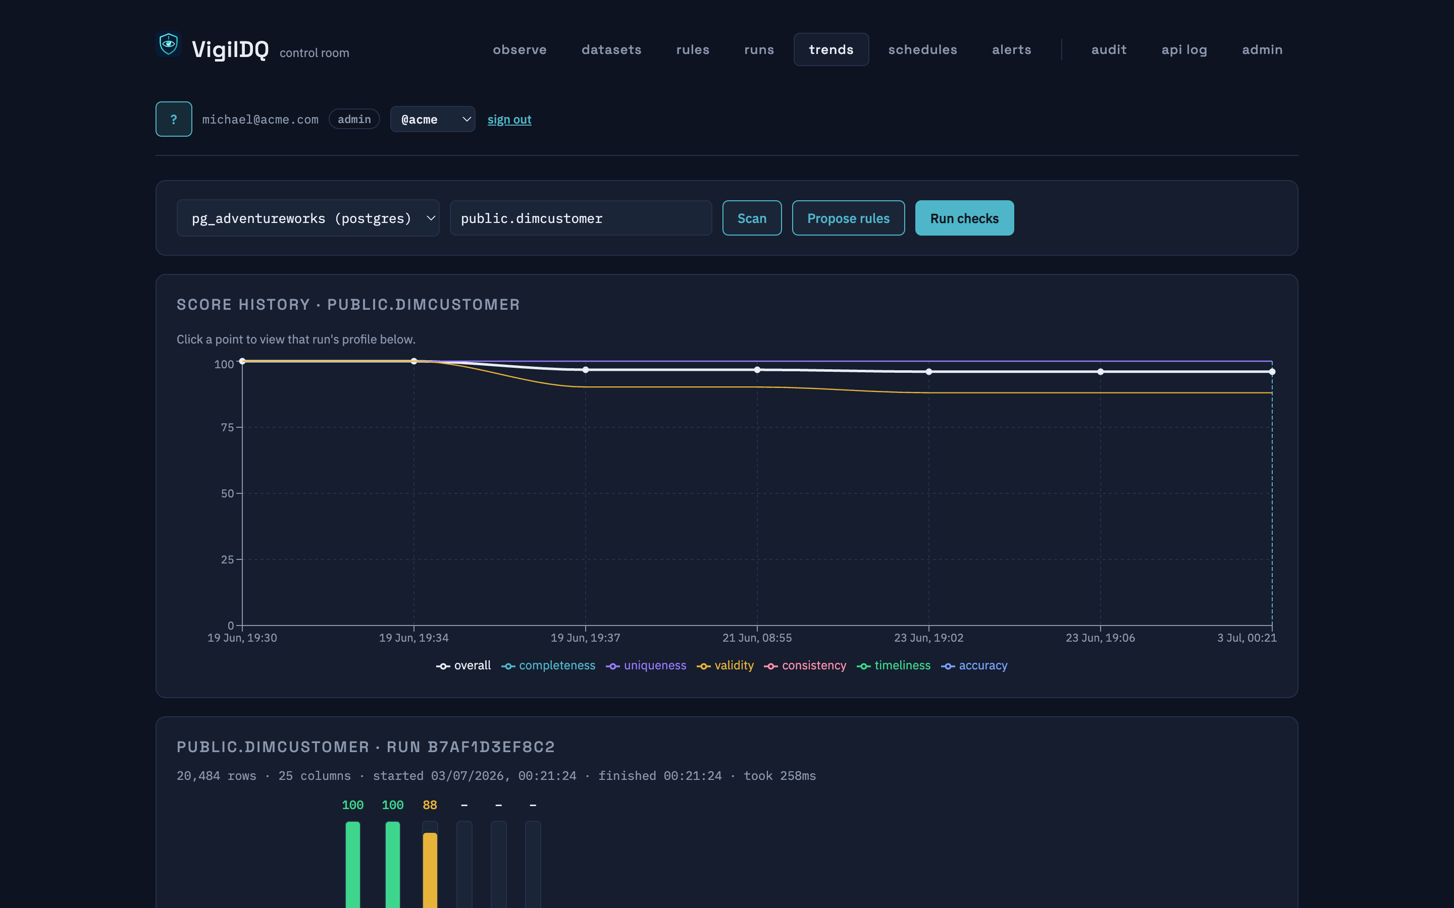
Track every run, watch the trend
every run: status, duration, score
score history + anomaly baselines per dataset
▸ Full run history with per-run scorecards and captured profiles.
▸ Drift rules (row count, null ratio, schema) judge against a median baseline — no day-one false alarms.
WHY IT MATTERS
Quality becomes a time series — regressions show up as a bend in the line, not a surprise in production.

Slide 10
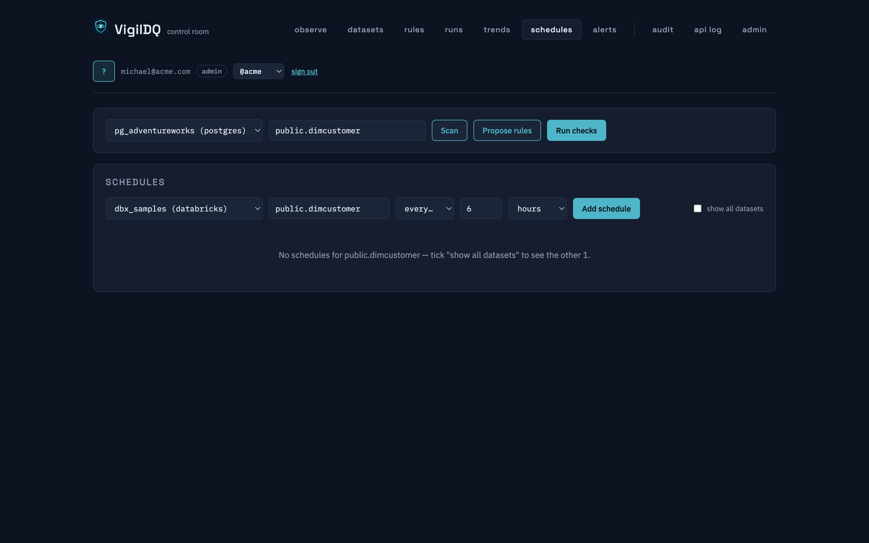
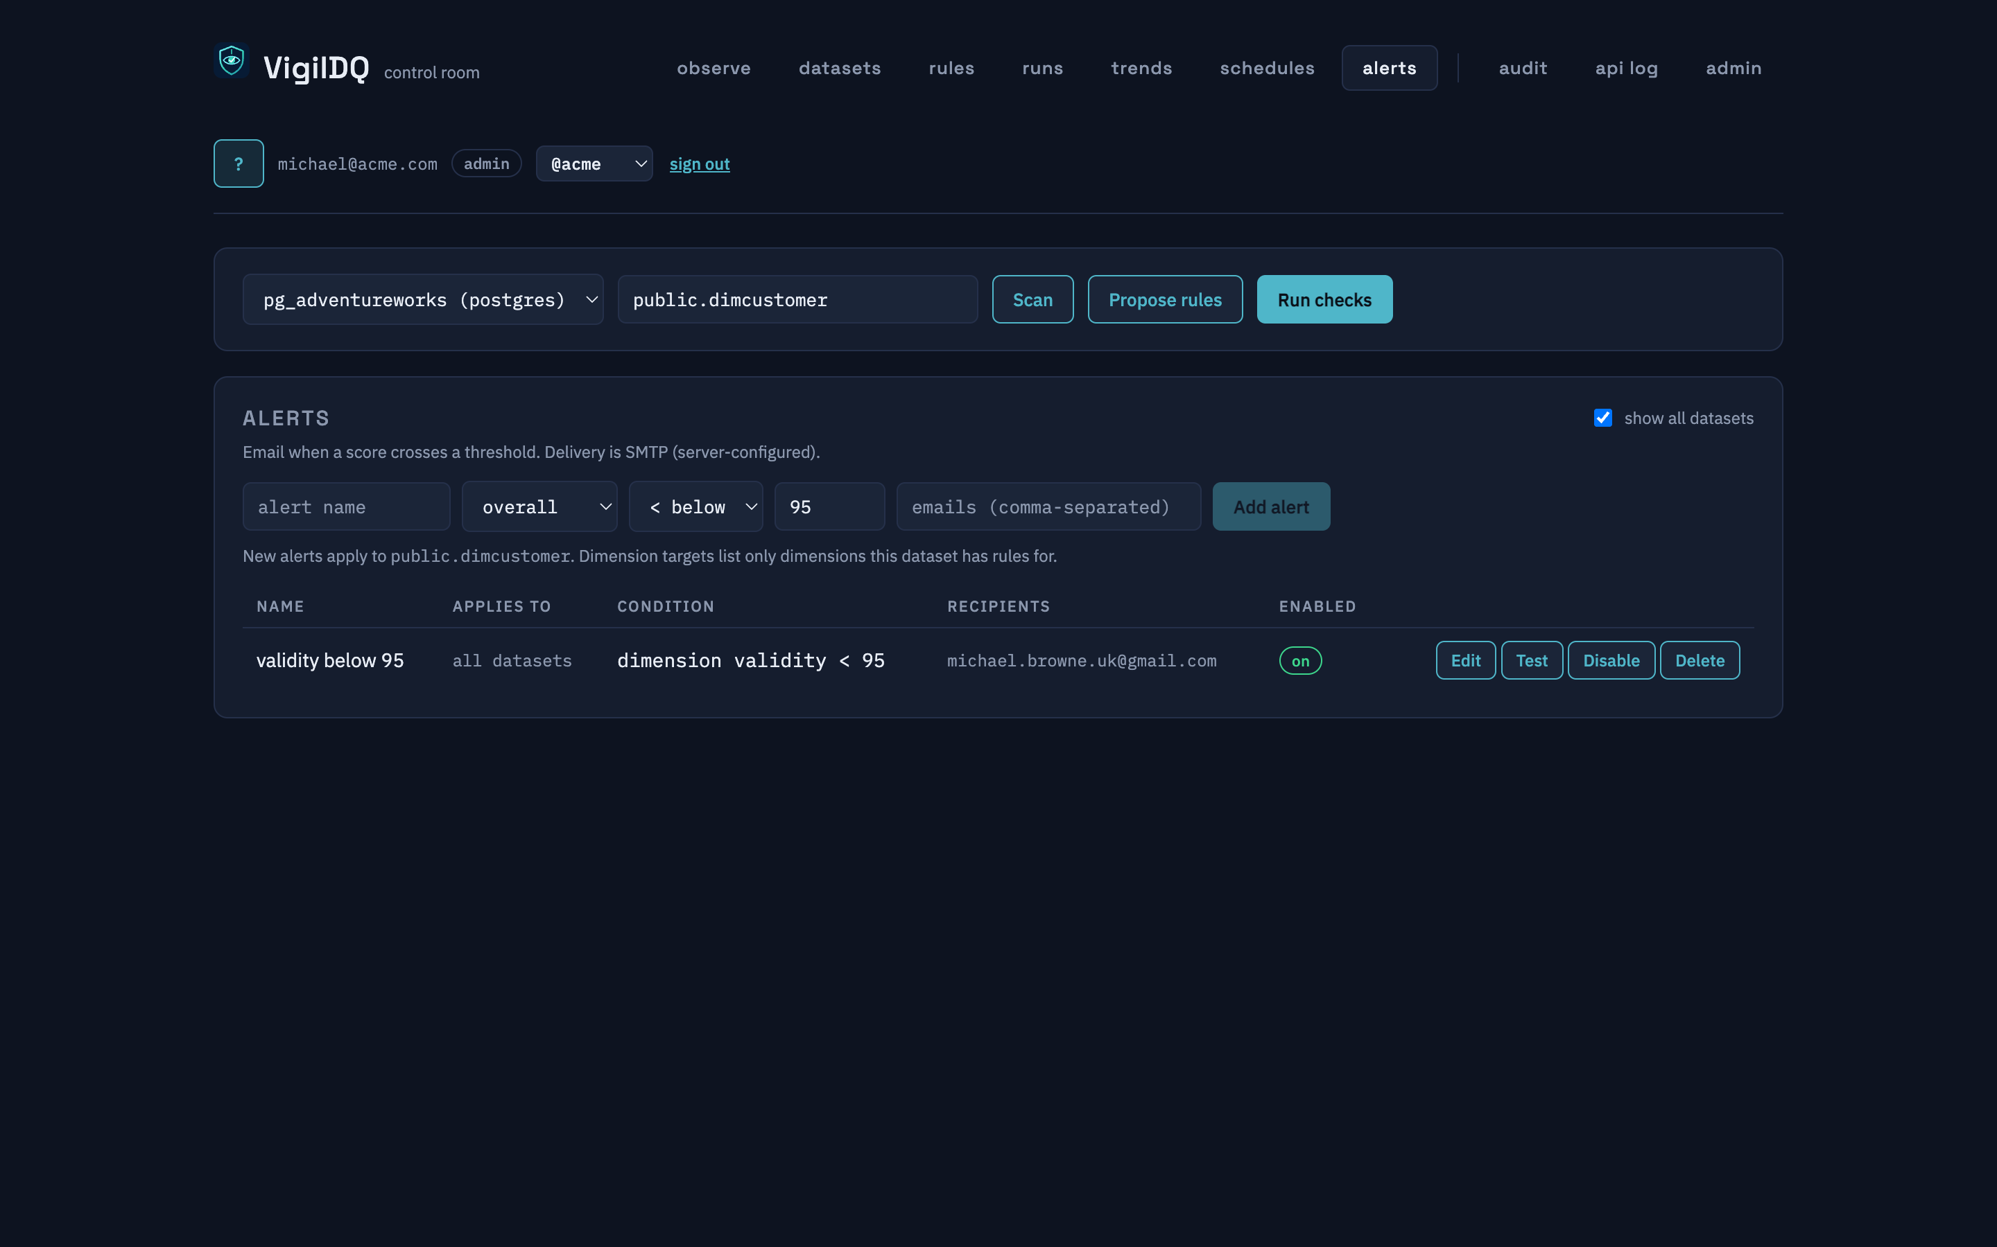
Automate: schedules, alerts, gates
structured cadences — interval / daily / weekly / monthly
score alerts → email; webhooks for gate-fail / anomaly
▸ Schedules run each dataset under its own tenant, with recorded health.
▸ Pipeline quarantine gates return pass/fail verdicts your orchestrator can branch on (Airflow, dbt, ADF...).
WHY IT MATTERS
Set thresholds once; the platform watches every load and tells you — or stops the pipeline — when quality slips.

Slide 11
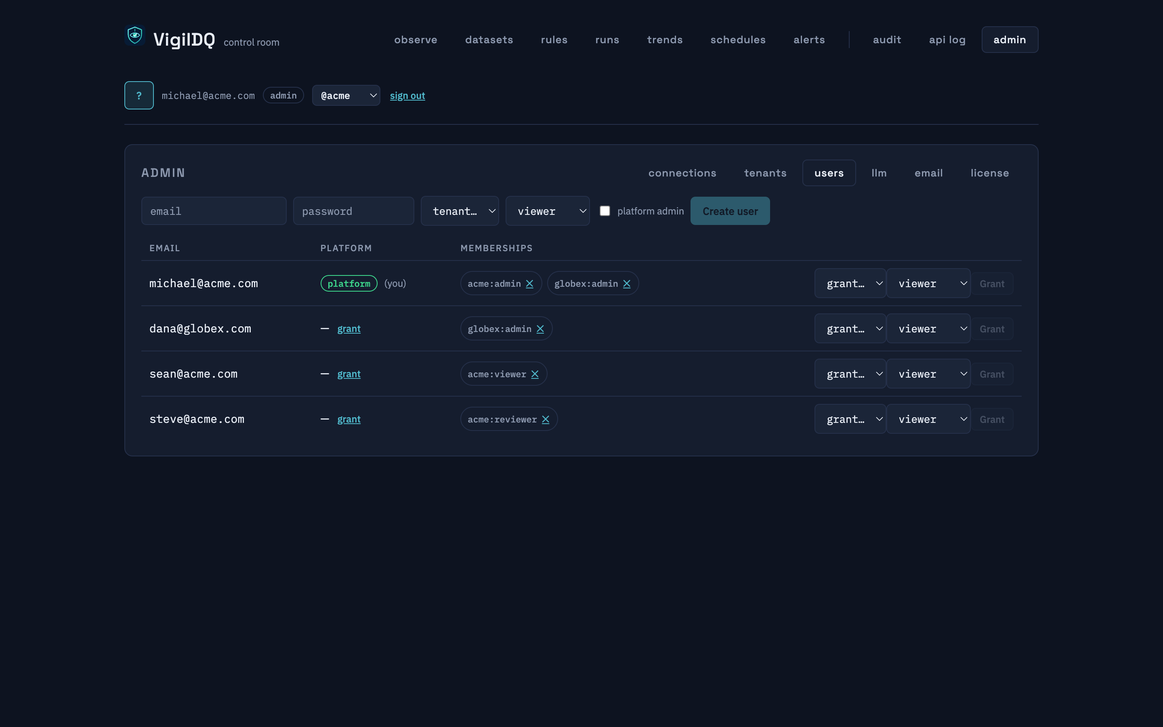
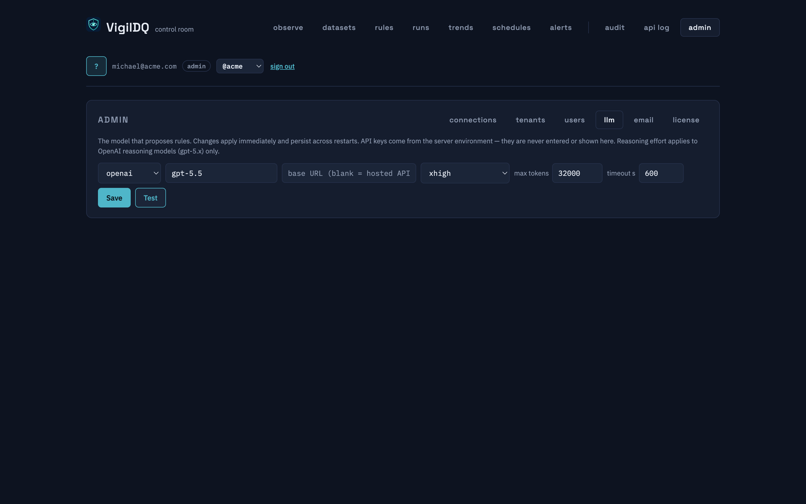
Multi-tenant administration
tenants, users, memberships, roles
the AI model — switchable at runtime, audited
▸ Shared-schema multi-tenancy; roles per tenant (admin/reviewer/viewer).
▸ Choose the LLM in the UI: hosted (Anthropic/OpenAI incl. reasoning models) or fully LOCAL via any OpenAI-compatible server.
WHY IT MATTERS
Bring your own model — including an on-prem LLM, so even the masked profile never leaves your estate.

Slide 12
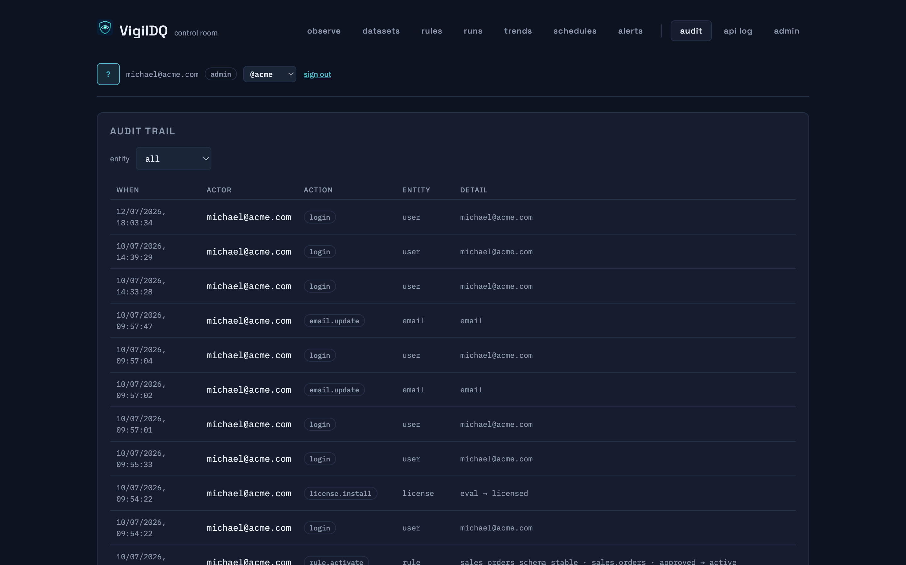
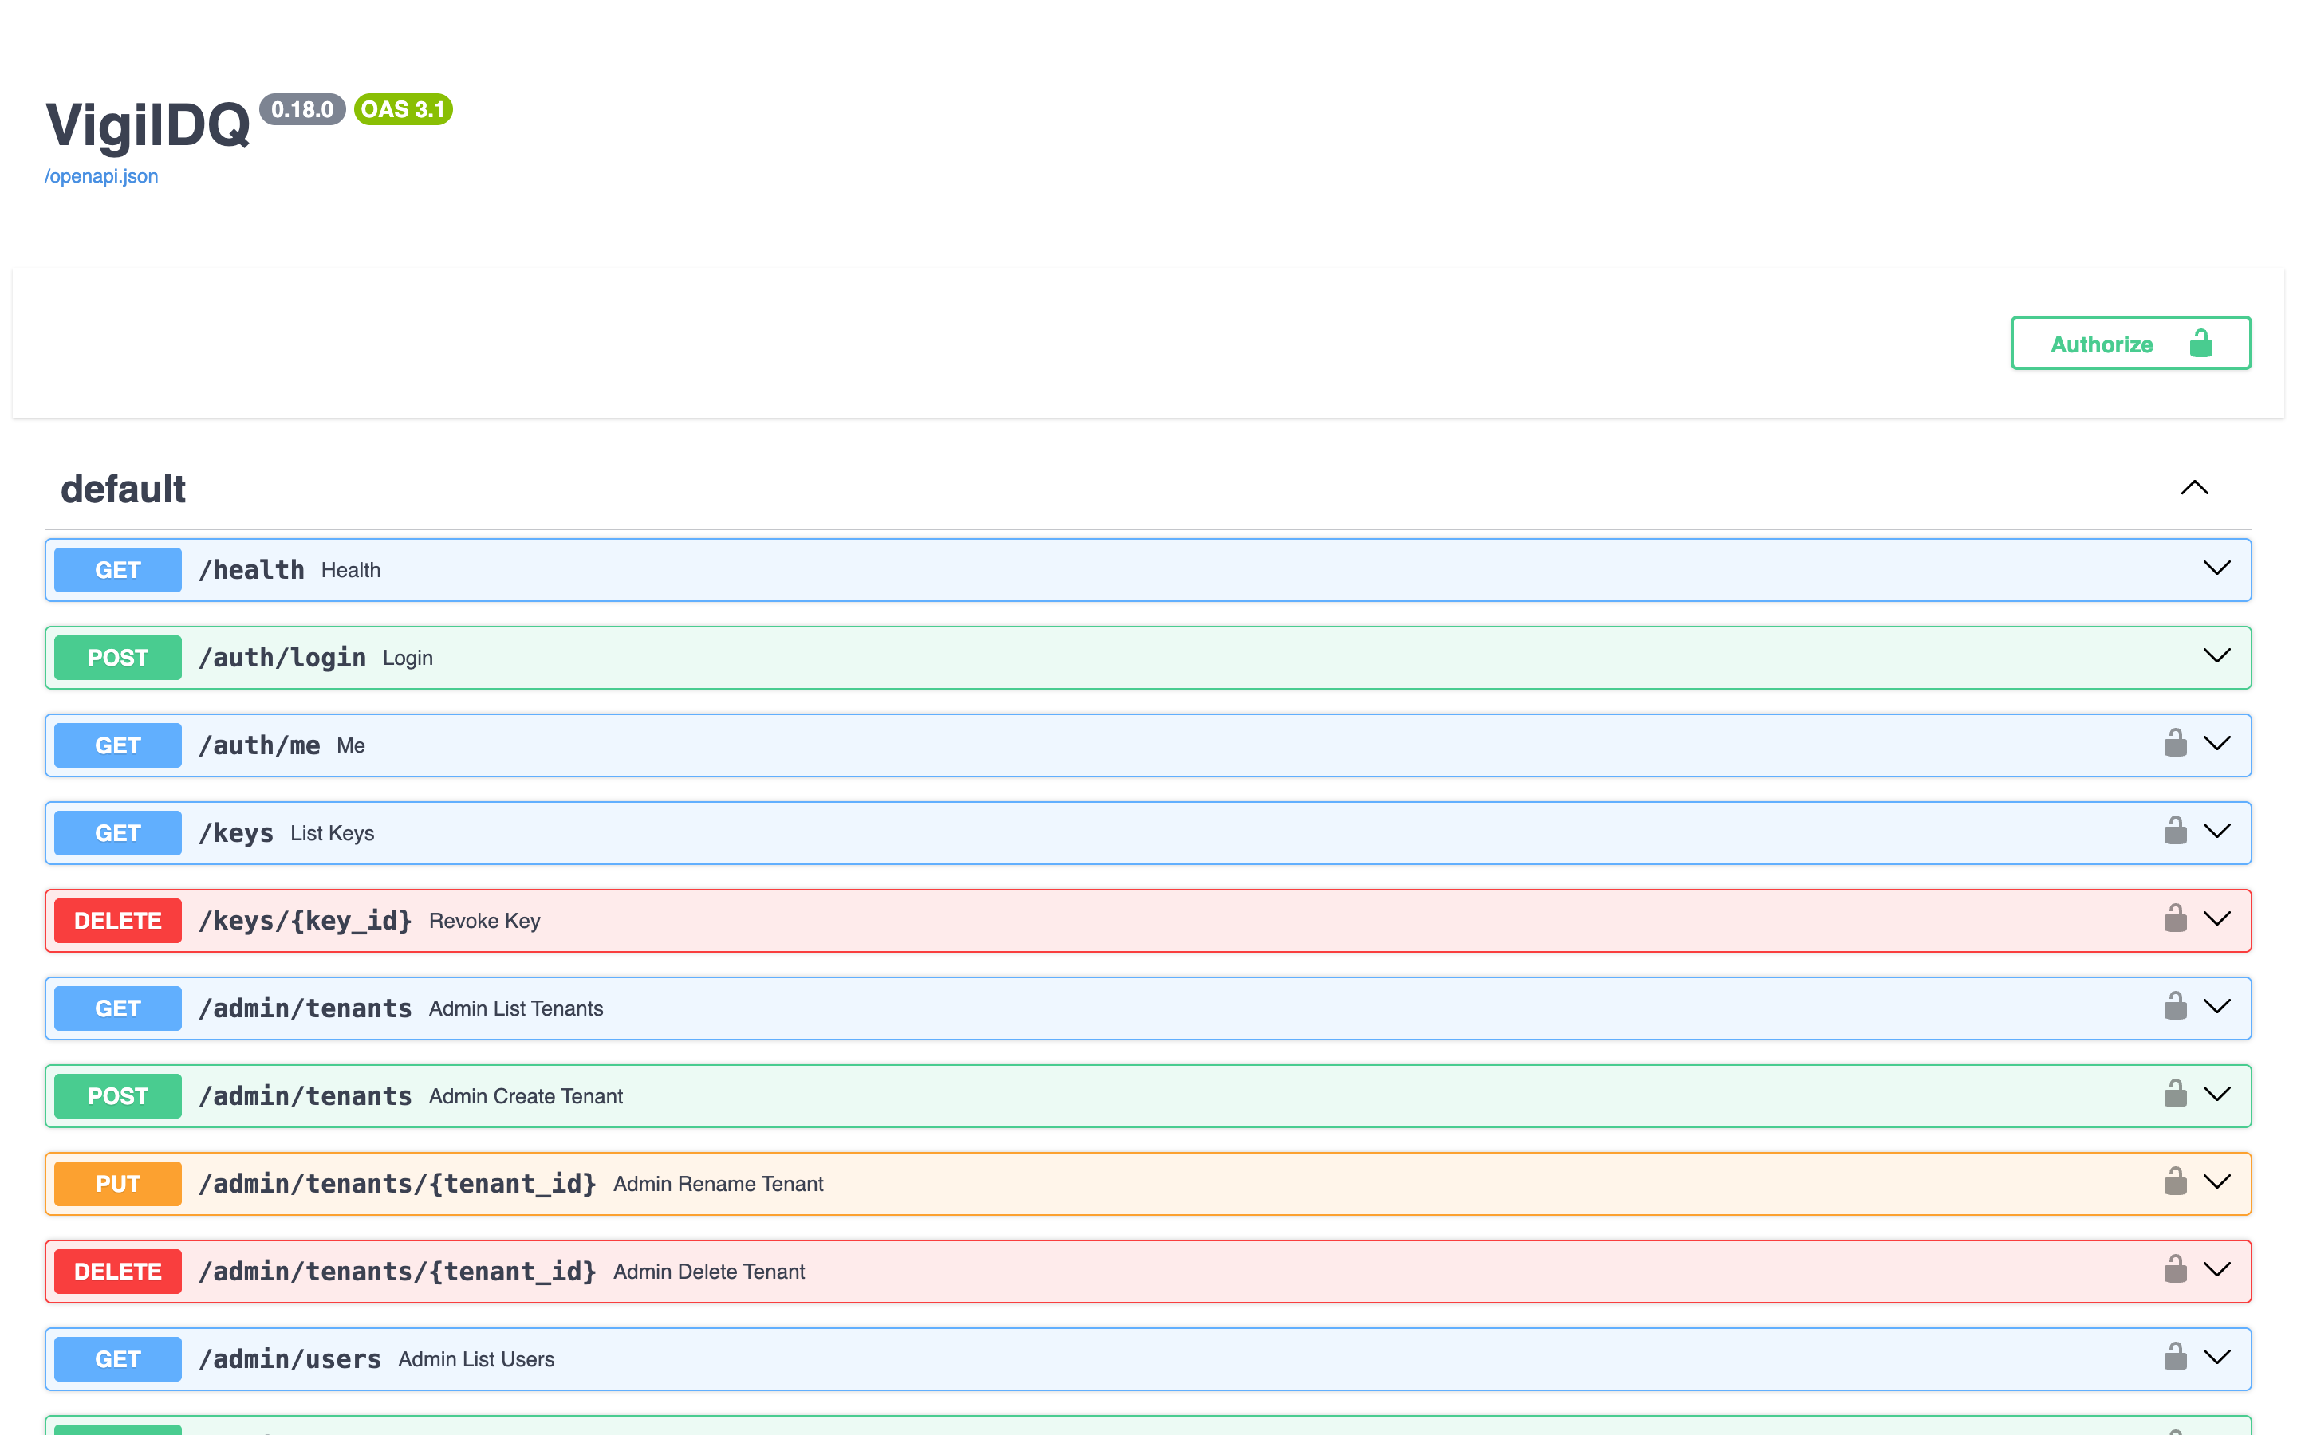
Audited end to end, scriptable end to end
mutating actions: who, what, before/after
the full REST API — everything the UI does
▸ Approvals, edits and config changes are appended to an append-only audit trail with before/after snapshots.
▸ The dashboard is a pure API client: anything you see here, your platform can automate.
WHY IT MATTERS
Compliance gets its evidence; engineering gets an API. Nobody has to trade one for the other.

Slide 13
Designed for regulated data
Guardrails as architecture
• Schema, read-only and dry-run gates — hallucinations cannot pass
• Prompts are advisory; gates make failure modes impossible
Fail closed
• A rule that cannot execute counts as a failed control
• A threshold with no rules is a breach, never a silent pass
Provable masking
• PII masked inside scan() — no unmasked code path exists
• Tests capture the agent's exact prompt and assert zero raw values
Audit trail
• Each control records the reviewer credential that certified it
• Append-only before/after snapshots for reconstruction and review

Slide 14
THE NEXT STEP
What a 30-minute demo adds
▸ The agent proposing rules live — and the review queue filling up.
▸ A guardrail refusing a bad rule live (a hallucinated column, a sneaky UPDATE).
▸ A quality gate wired into a pipeline: pass, fail, quarantine.
▸ All on our sandbox warehouse — nothing to install, no access to your systems.

Slide 15
Watch it catch bad data — live.
Everything in this pack is real and running today. A 30-minute demo adds the parts a PDF can't:
watching the agent propose rules live, a guardrail refusing a bad rule, and a quality gate stopping a bad load.
Arrange a demo → hello@vigildq.com · vigildq.com
The demo runs entirely on our sandbox warehouse — nothing to install, no access to your systems needed.

